Slide 1
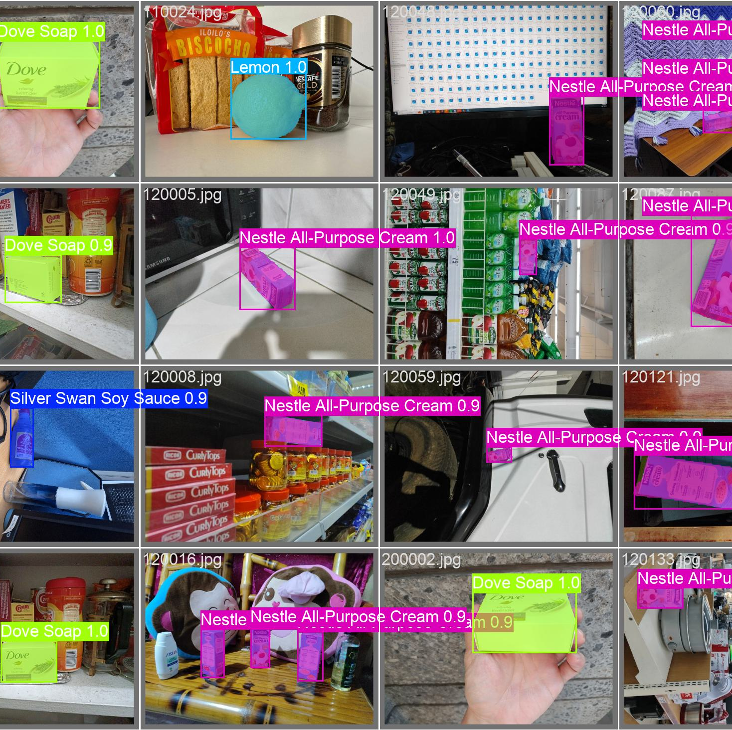
Machine Exercise 5 – Grocery Detection Miguel Luis Martinez
Uses YOLOv11 fine-tuned on grocery dataset
24 classes, 7604 train + 845 val in total
Preprocessing used to convert COCO to YOLO and fix incorrectly oriented/sized annotations
Train over 500 epochs

Slide 2
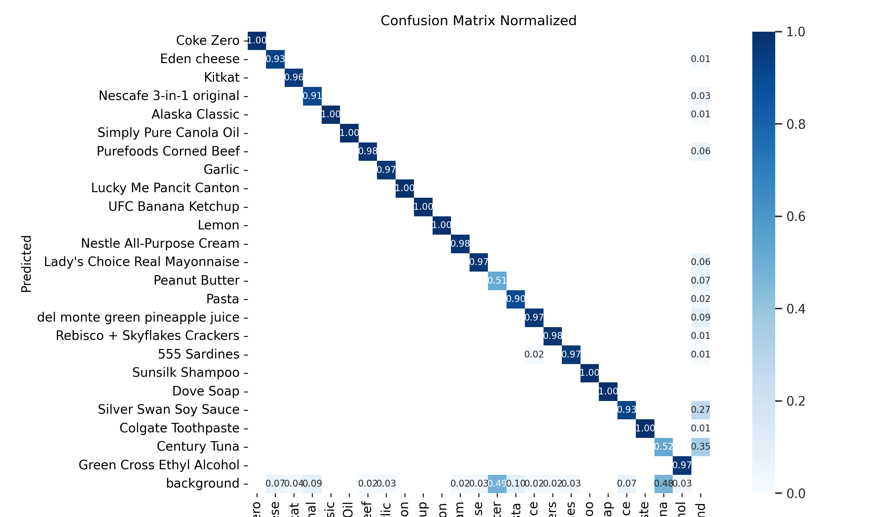
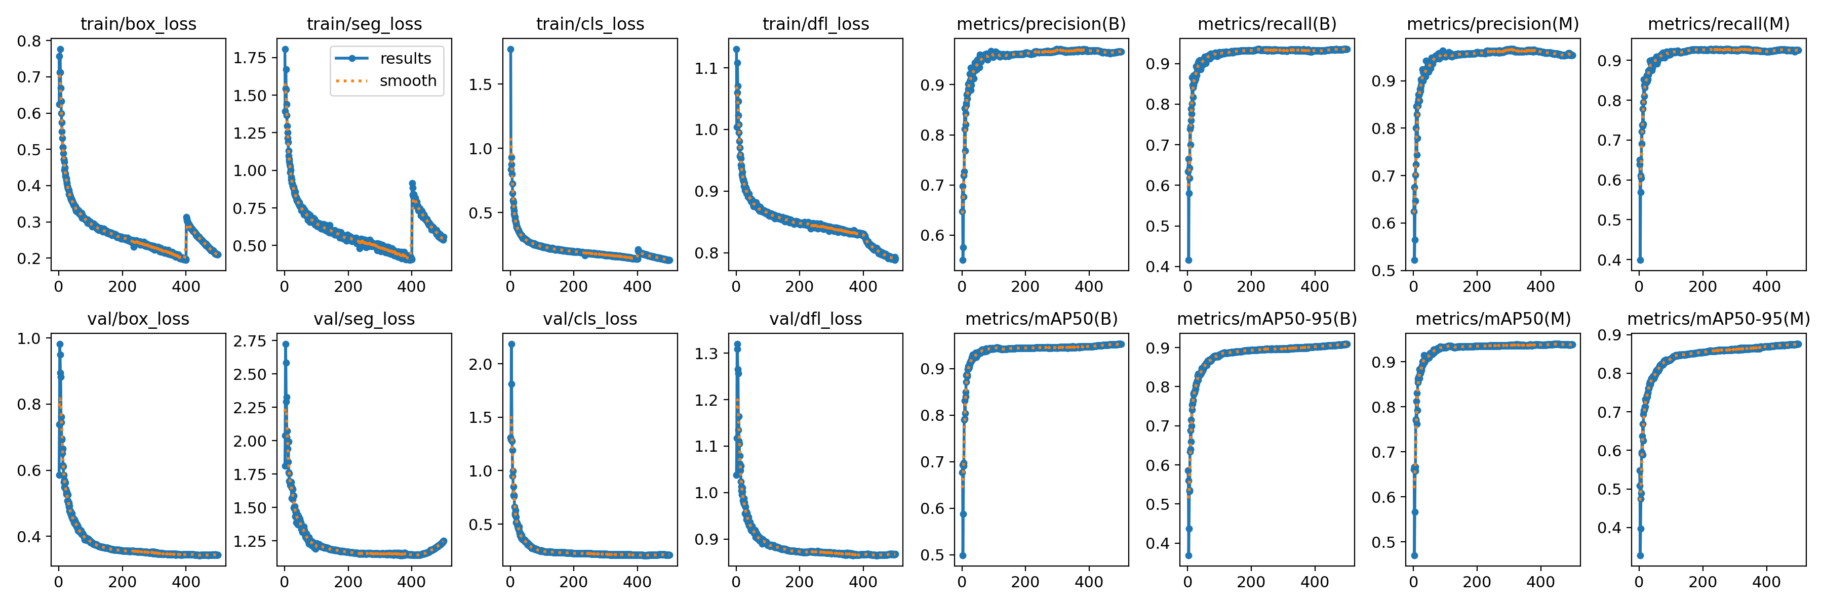
Training Results
Model | Precision | Recall | mAP50 | mAP50-95
YOLO11 M Segment | 0.95386 | 0.92581 | 0.9384 | 0.8758
YOLO11 S Segment | 0.95634 | 0.9161 | 0.93181 | 0.84751
YOLO11 N Segment | 0.95788 | 0.92526 | 0.93911 | 0.87137
High precision and recall (precision is higher)
“Mosaic” used in training until 400th epoch, explaining decrease in segmentation loss

Slide 3
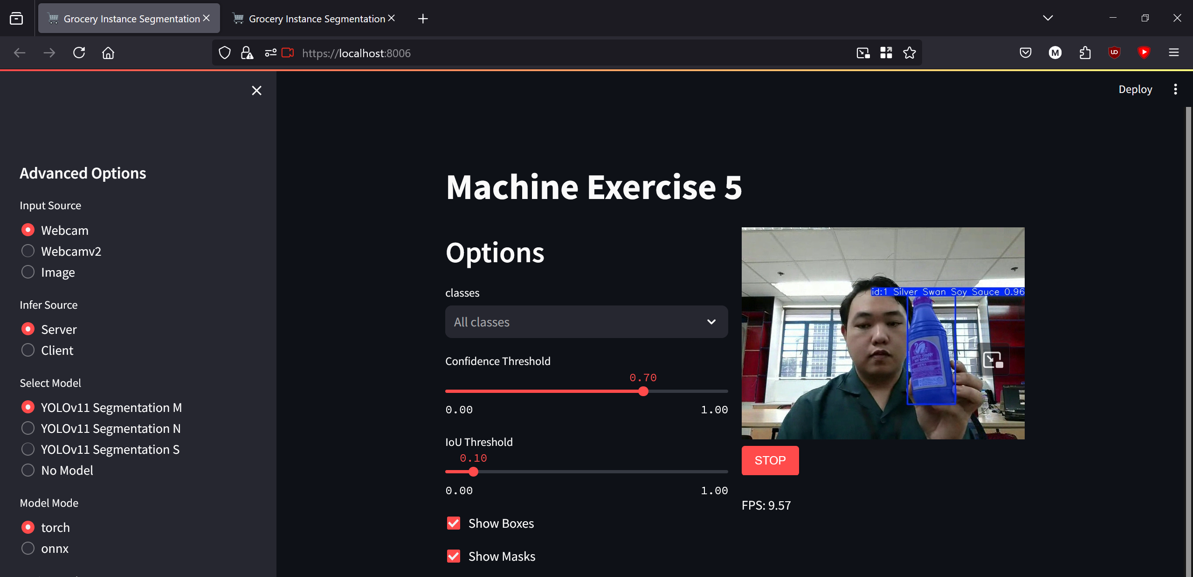
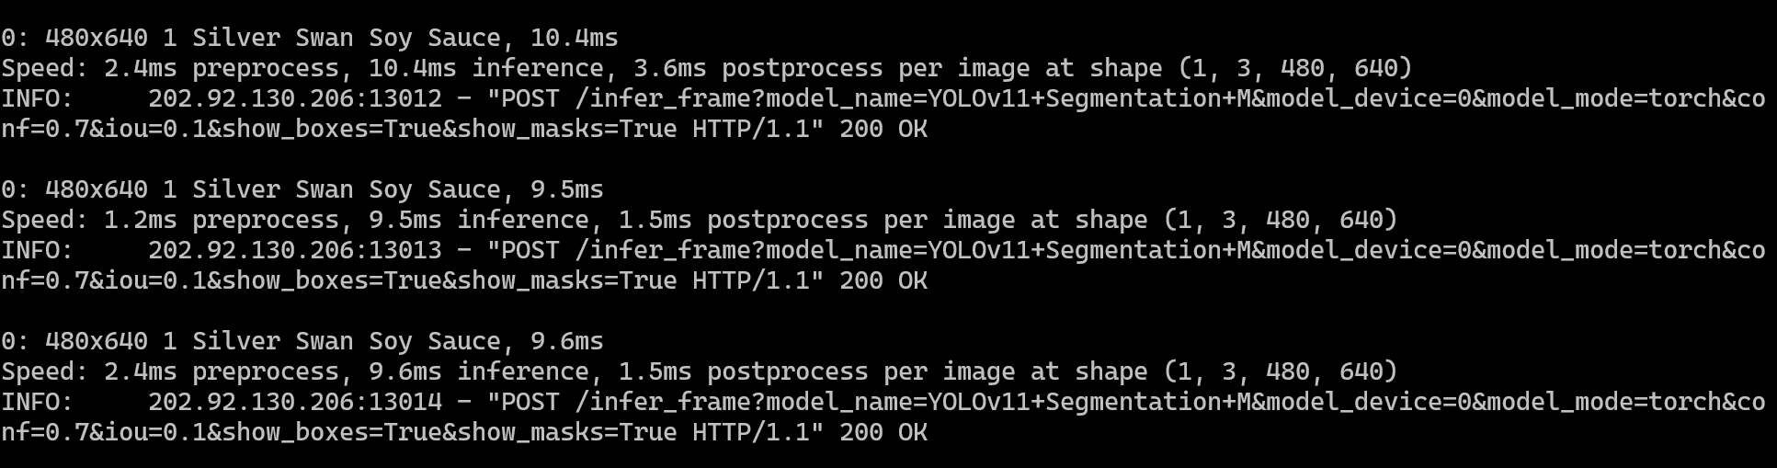
Application
Uses streamlit for client frontend
Supports local inference and server-side inference (with server script to process images)
Can select one or more specific class to segment

